Slide 1
Heart Monitor
Noha Mohamed
900163073
https://github.com/noha158/HeartMonitor

Slide 2
Outline
Project Overview
Devices used
The C code
The Python Code
Results
Demo

Slide 3
The Project
I chose the second project which is the heart monitor project.
In this project we are tasked with reading a signal for the ECG, plotting it and displaying the plot.
We are supposed to use the ECG A8232 Heart Rate Sensor to measure the heart rate and the STM32 board to send the signal to the computer via serial port.
We then calculate and plot the bpm (beats per minute)

Slide 4
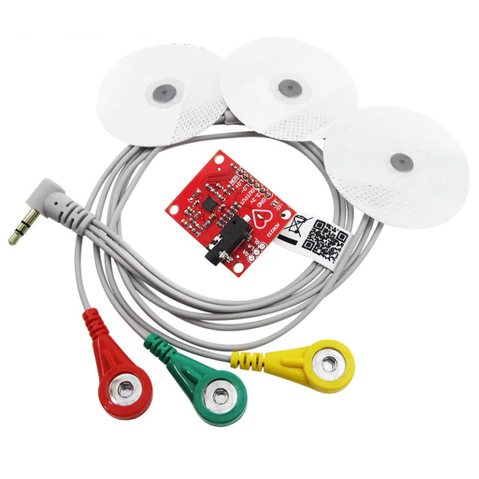
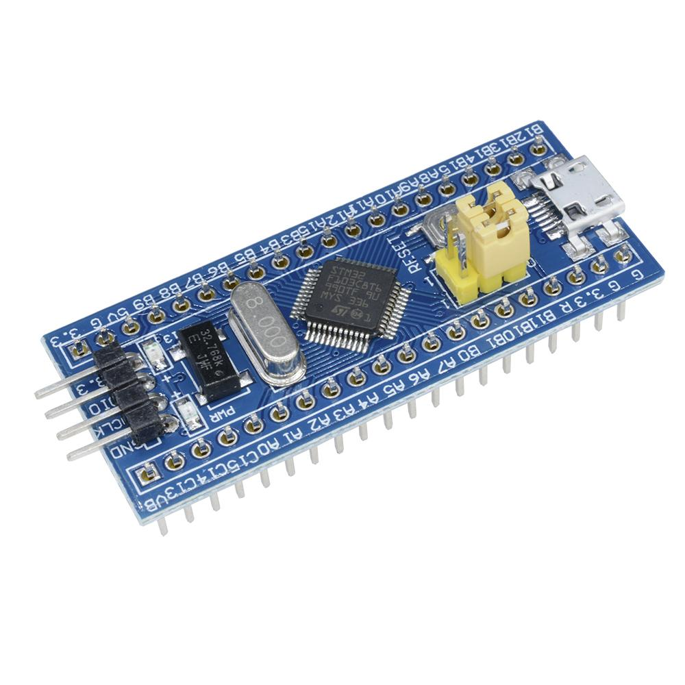

Devices Used

Slide 5
Devices Used
The ECG measures the heart rate.
I use the STM32F103C8 microcontroller to send the signal to my computer through the serial link.
My Computer Receives and plots the data.
The computer also initiates interaction with the microcontroller by sending commands that begin the sampling process.

Slide 6
The C Code
In the main I call the HAL_UART_Receive_IT function in order to receive through the UART.
In the UART handler, I save the received data and start the ADC.
I also configure the Systick timer based on the sampling rate.

Slide 7
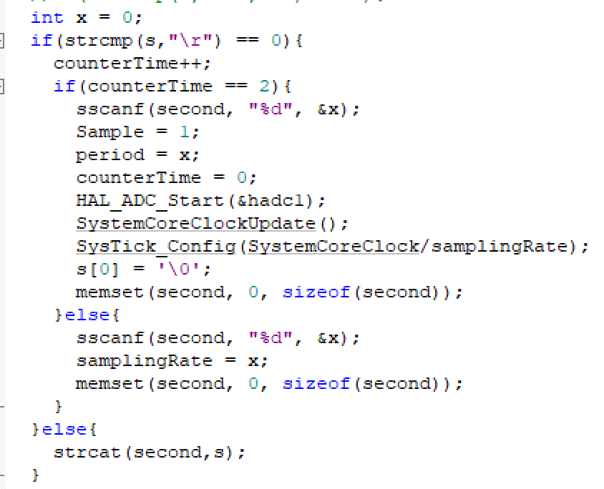
The C Code

Slide 8
The C Code
I take, as an input through the UART, the sampling rate and the period for which the code will run in that order.
Once the period is saved, I set the Sample flag to 1 and start the ADC

Slide 9
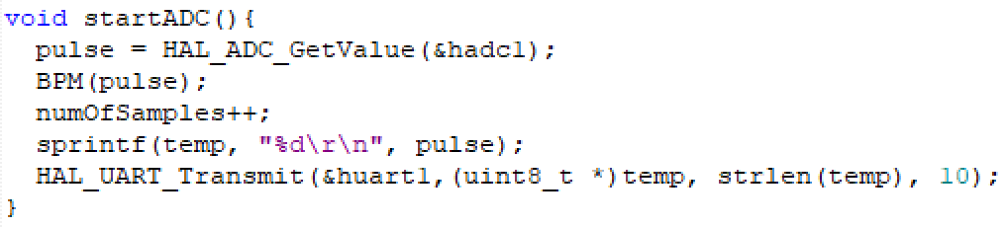
The C Code
In order to read the digital signal from the ADC I created the startADC function shown below:

Slide 10
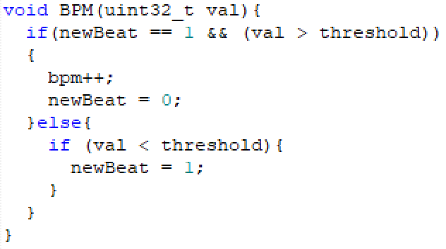
The C Code
The BPM function increments the BPM variable if the current value is above a certain threshold and the previous value is below it.

Slide 11
The C Code
In order to allow the ADC to sample for one minute only I used the Systick timer, and I kept reading samples as long as the time was less than the period*sampling rate.
If the specified period has passed, then I reset all my flags, stop the ADC, and Suspend the Systick interrupt.

Slide 12
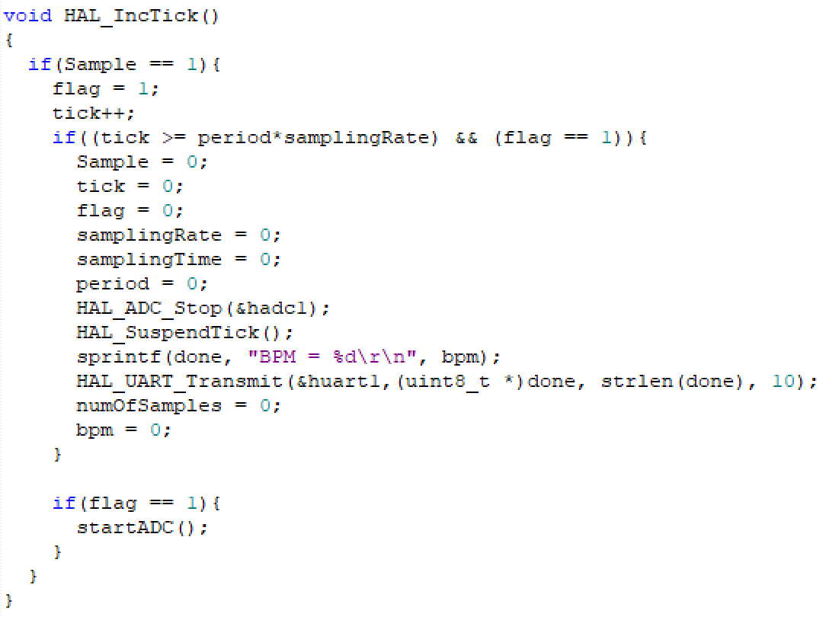
The Code

Slide 13
The Code
The Sample variable shown in the code in the previous slide is used to enable sampling only when both the sampling rate and the period are set.
Once Sample is set, I begin reading samples from the ADC.
This will be a way to enable reading the signal when I start sending commands through the UI.

Slide 14
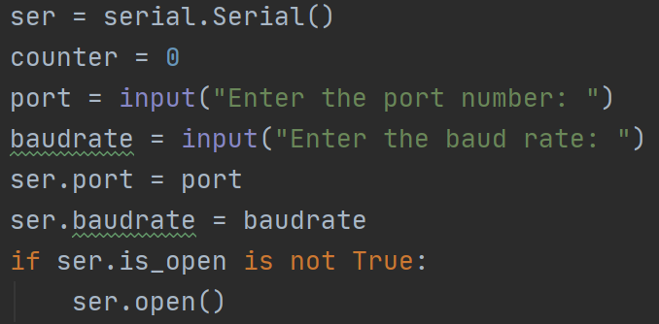
The Python Code
I implemented a simple UI using Python’s PySerial and matplotlib.
PySerial was used in order to establish a connection with with the serial port.

Slide 15
The Python Code
I plotted the ECG’s signal live using matplotlib’s animation.FuncAnimation function.
Plotting the Signal at the same rate as the sampling rate made the graph refresh very slowly.
That’s why I plot a list of signals at a time.

Slide 16
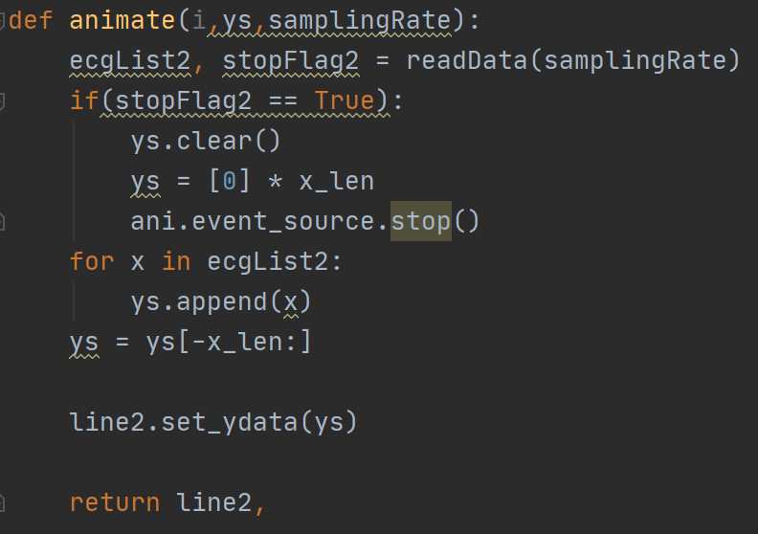
The Python Code

Slide 17
The Python Code
The readData function collects samples and saves them in a list to be plotted at a time.
The amount of stored samples is a function of the sampling rate, it’s 25% of the sampling rate to be exact
This way my graph’s refresh rate is 0.25*sampling rate frames/second.

Slide 18
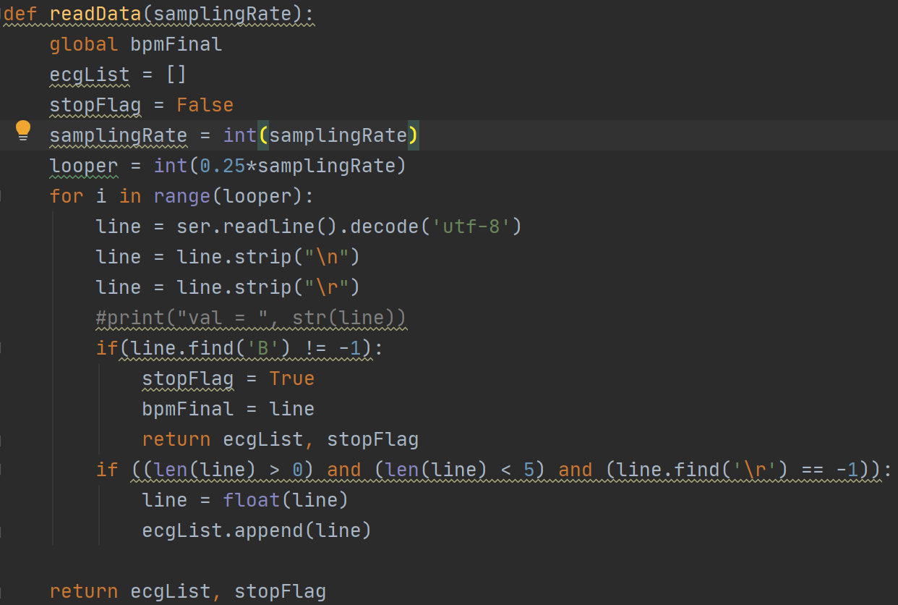
The Python Code

Slide 19
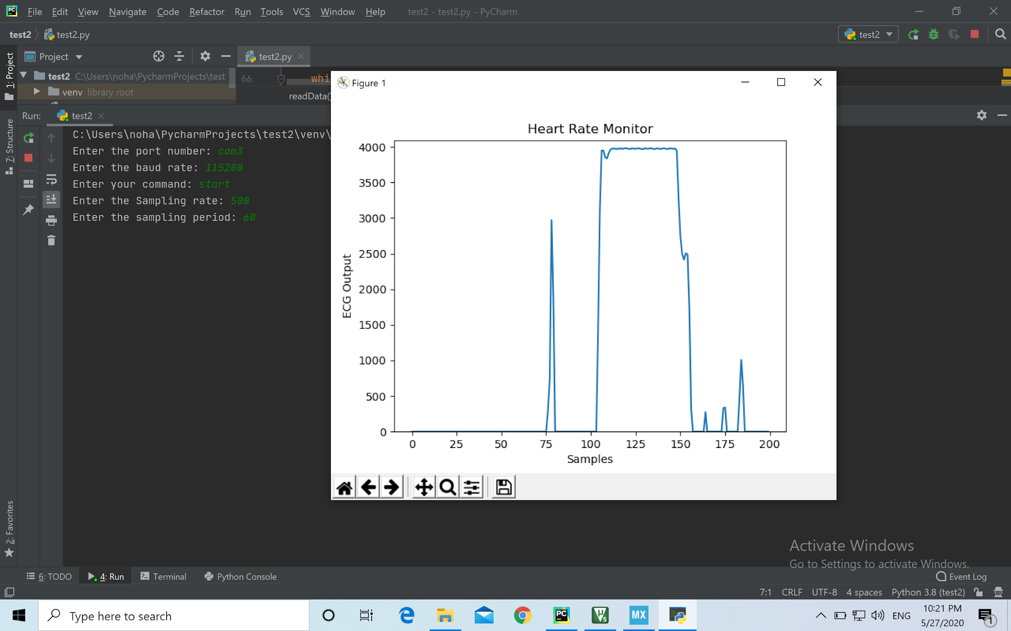
Results

Slide 20
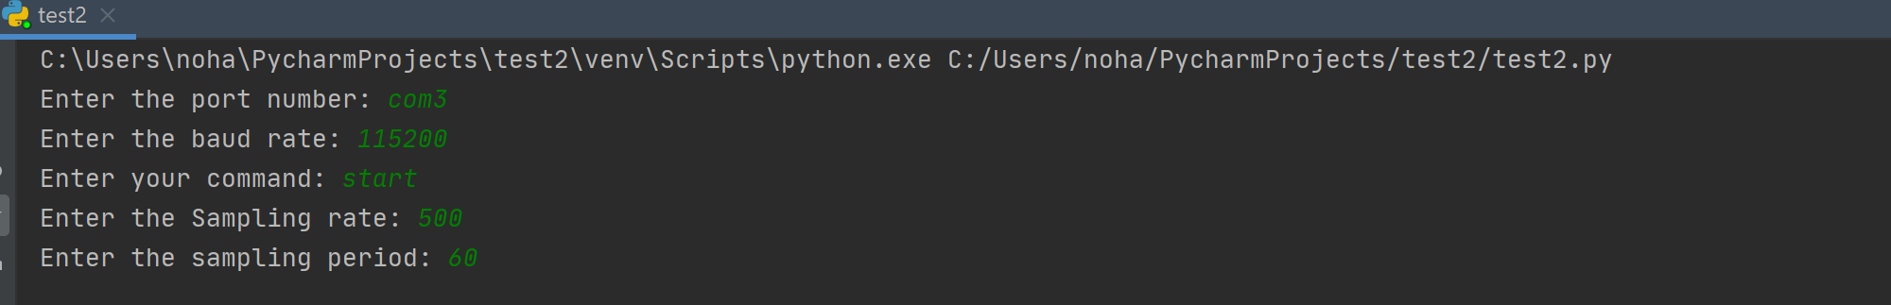

Results

Slide 21
DEMO

Slide 22
Thank you

